Slide 1

Introduction to React.js

Slide 2
What is React.js?
Developed by Facebook
React is a view layer library, not a framework like Backbone, Angular etc.
You can't use React to build a fully-functional web app
For React you should aware with JavaScript Version ES6

Slide 3
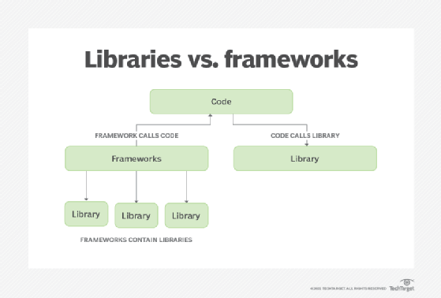
Library vs framework

Slide 4
What is ES6?
ES6 stands for ECMAScript 6.
ECMAScript was created to standardize JavaScript, and ES6 is the 6th version of ECMAScript, it was published in 2015, and is also known as ECMAScript 2015.

Slide 5
React: prerequisite
Classes
Arrow Functions
Variables (let, const, var)
Array Methods like .map()
Destructuring
Modules
Ternary Operator
Spread Operator

Slide 6






Who uses React?

Slide 7
React: Advantages
Easy to understand what a component will render
You don't really need to study JS in the view file in order to understand what the file does
Excellent cross-platform support.
Handles dependencies.
Template designing made easy.
Provides amazing developer tools.
Easy to mix HTML and JS

Slide 8
React: Uses full power of JS
React. js is an open-source JavaScript library that is used for building user interfaces specifically for single-page applications. It's used for handling the view layer for web and mobile apps. React also allows us to create reusable UI components.

Slide 9
React is fast!
Real DOM is slow
JavaScript is fast
Using virtual DOM objects enables fast batch updates to real DOM, with great productivity gains over frequent cascading updates of DOM tree

Slide 10
React: Disadvantages
React is nothing but the view
No events
No XHR
No data / models
No promises / deferred
No idea how to add all of the above

Slide 11
Why was React developed?
Complexity of two-way data binding
Bad UX from using "cascading updates" of DOM tree
A lot of data on a page changing over time
Complexity of Facebook's UI architecture
Shift from MVC mentality

Slide 12
Most important terms in React
Component
Props
State
JSX
Virtual DOM

Slide 13
React: Component
Components are self-contained reusable building blocks of web application.
React components are basically just idempotent functions (same input produces same output).
They describe your UI at any point in time, just like a server-rendered app

Slide 14
React: Props
Passed down to component from parent component and represents data for the component
React Props are like function arguments in JavaScript and attributes in HTML.
To send props into a component, use the same syntax as HTML attributes:

Slide 15
React: State
Represents internal state of the component
Accessed via this.state
When a component's state data changes, the rendered markup will be updated by re-invoking render() method

Slide 16
React: JSX
Arguably, one of the coolest things in React
XML-like syntax for generating component's HTML
Easier to read and understand large DOM trees
Translates to plain JavaScript using react-tools

Slide 17
React: Virtual DOM
The virtual DOM is used for efficient re-rendering of the DOM
React aims to re-render the virtual tree only when the state changes
Uses 2 virtual trees (new and previous) to find differences and batch update real DOM
Observes data changes (setState) and does dirty-checking to know when to re-render component
Whenever possible, does not update entire component in real DOM - only computes a patch operation that updates part of the DOM

Slide 18
Why should I use React?
Easy to read and understand views
Concept of components is the future of web development
If your page uses a lot of fast updating data or real time data - React is the way to go
Once you and your team is over the React's learning curve, developing your app will become a lot faster

Slide 19
ANY QUESTION ?

